Slide 1
Pursuing a Passion Project: Struggles and successes

Slide 2

Hello!
I am Sarah Withee
I’m a polyglot software engineer, pubic speaker, hardware tinkerer, geek
You can find me at @geekygirlsarah

Slide 3
1.
What is a Passion Project?
Notes:
Most people have a Big Idea and want to make a company off of it, or do something to make money from it

Slide 4
A passion project is a project pursued solely because you’re passionate about it (and not about the money)
Notes:
It could be a ton of work, but you’re dedicated to seeing it through

Slide 5
2.
The Big Idea
A combination of tiny, baby ideas
Notes:
a. Wanted a way to support women in tech, LGBTQ people in tech, disabled or otherwise underrepresented groups in tech
b. Thought it might be interesting to make videos, or start a podcast or something
c. always fall asleep or zone out at audio podcasts
d. have backgrounds doing video editing, running sound for bands, something something probably have more
e. hanging out in women in tech slack and other places and connecting with many people one-on-one, I knew a lot of people did a lot of cool things, even though they weren't "big names" in tech. Also met a lot of "big names in tech" before they became more big names.

Slide 6
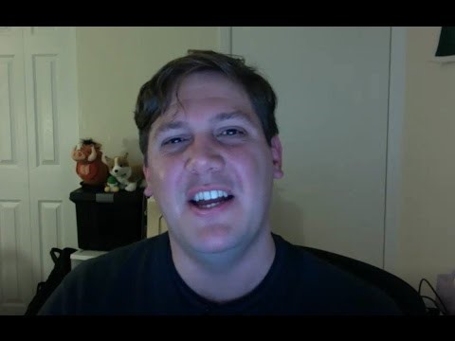
Becoming a data scientist
Notes:
f. Discovered Becoming a Data Scientist one day, a video podcast by Renee Tete. Liked her style of chatting with someone about data science
g. realized "I really love connecting with people and wonder why maybe this couldn't be a thing?"
h. also thought it would be cool to show off projects and websites and such via video
i. the idea of a non-men (women in tech/lgbtq in tech) podcast was sort of born, but had no real name
j. after a conversation with @aredridel about some issues in tech, she mentioned "the rest of us", which was great, but sounded really vague or too broad
k. why not "in tech"? to represent the rest of us that are often not heard about but still just as awesome

Slide 7
Big
Idea!!
Why not make a podcast for underrepresented groups in tech!?!

Slide 8
3.
Testing the idea
Can I even do this??
Notes:
a. I knew it would be a lot of work, especially from my background in video and audio work
b. I knew tracking down people would be a lot of work
c. I knew trying to interview people in a way that would result in engaging discussion others would want to listen to would be a lot of work
d. I wanted to also talk about this idea in a way that would help others encourage me, but not actually admit what it was in case it failed (like many of my side projects get abandoned)
e. Decided to do 3 "beta" episodes to see if I could pull it off. If they failed, no big deal. If they succeeded and felt I had the energy to pull off, then I could do it
f. …… talk about steps to doing this
g. decided that this was potentially doable even with few remaining quirks I had to resolve

Slide 9
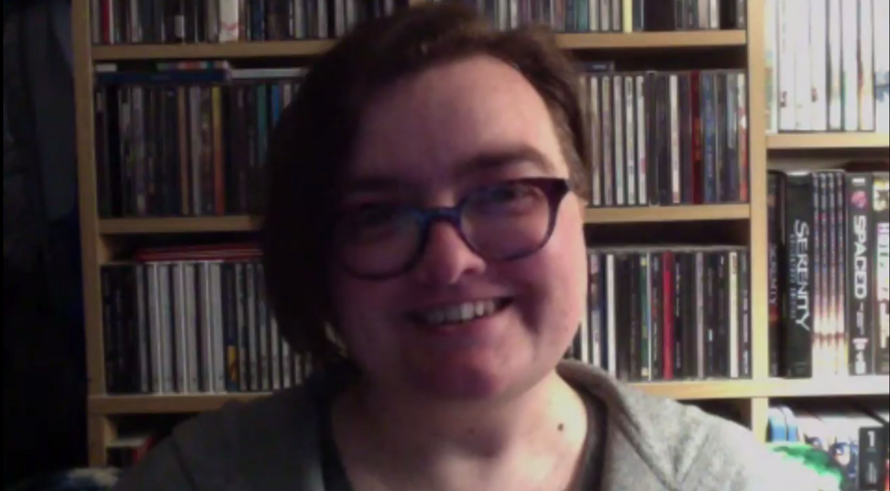
Beta episode 1
Notes:
[Note: replaced video with still for adding to GitHub]
a. I knew it would be a lot of work, especially from my background in video and audio work
b. I knew tracking down people would be a lot of work
c. I knew trying to interview people in a way that would result in engaging discussion others would want to listen to would be a lot of work
d. I wanted to also talk about this idea in a way that would help others encourage me, but not actually admit what it was in case it failed (like many of my side projects get abandoned)
e. Decided to do 3 "beta" episodes to see if I could pull it off. If they failed, no big deal. If they succeeded and felt I had the energy to pull off, then I could do it
f. …… talk about steps to doing this
g. decided that this was potentially doable even with few remaining quirks I had to resolve

Slide 10
4.
Going into production
Let’s get started! (For real this time)
Notes:
a. I had a ton of feedback from my "beta testers" (as I referred to this as it wasn't public). And knew I needed to get some more things right to make it look professional
b. bought some lights, bought a backdrop, and bought a nice microphone (something I wanted anyway). So about $150 later, I ahd a "studio" [insert picture]
c. Found some software that was better than what I tried before and more reliable. Also bought a new computer to replace the 9-year-old one that wasn't recording HD streaming video that great anymore.
d. Recorded my first interview then.....
e. life dragged me down into a bad ball of depression

Slide 11
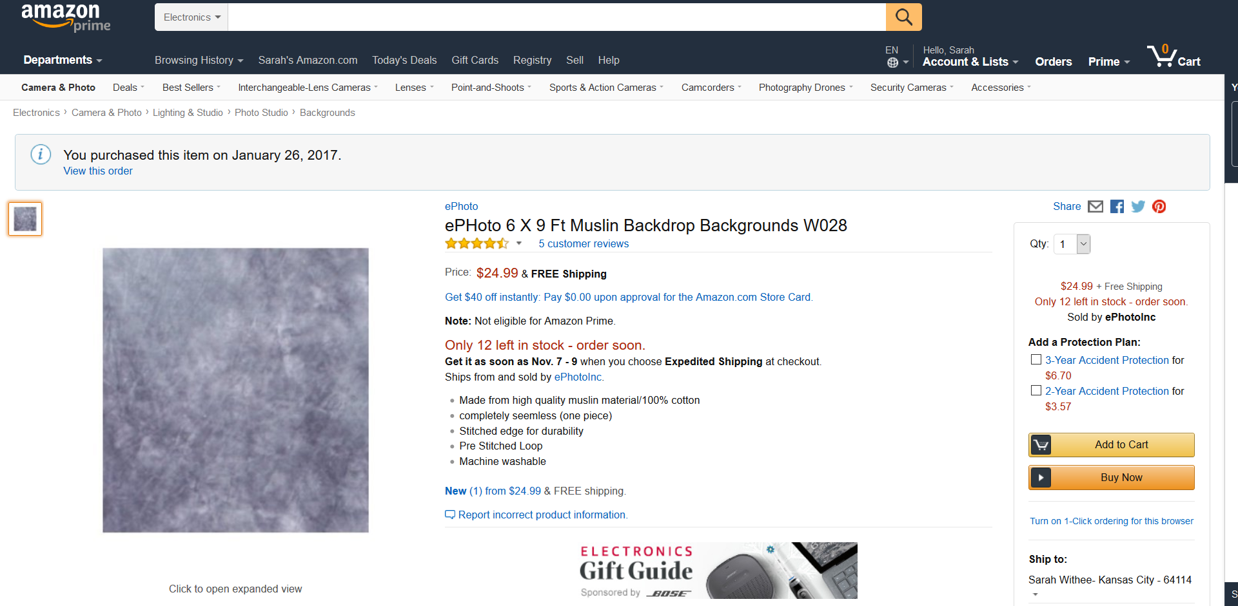
The “studio”
Notes:
I bought a cheap backdrop…

Slide 12
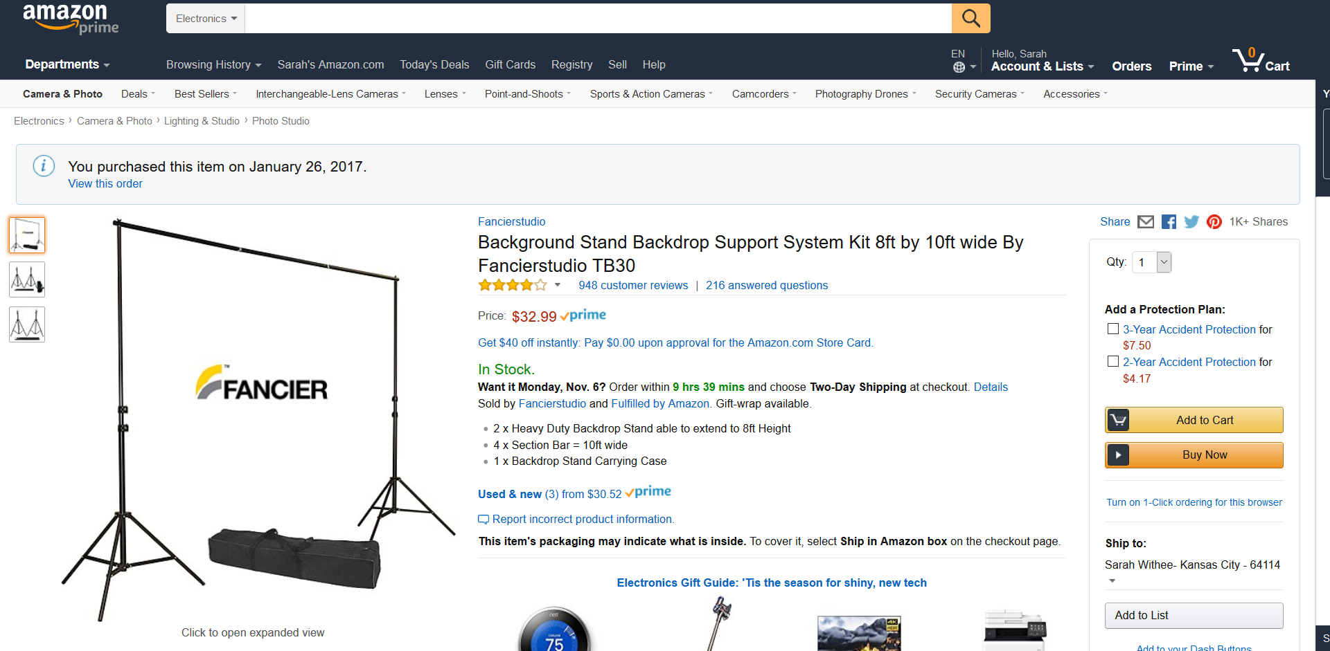
The “studio”
Notes:
… and a tripod frame to hang it up from…

Slide 13
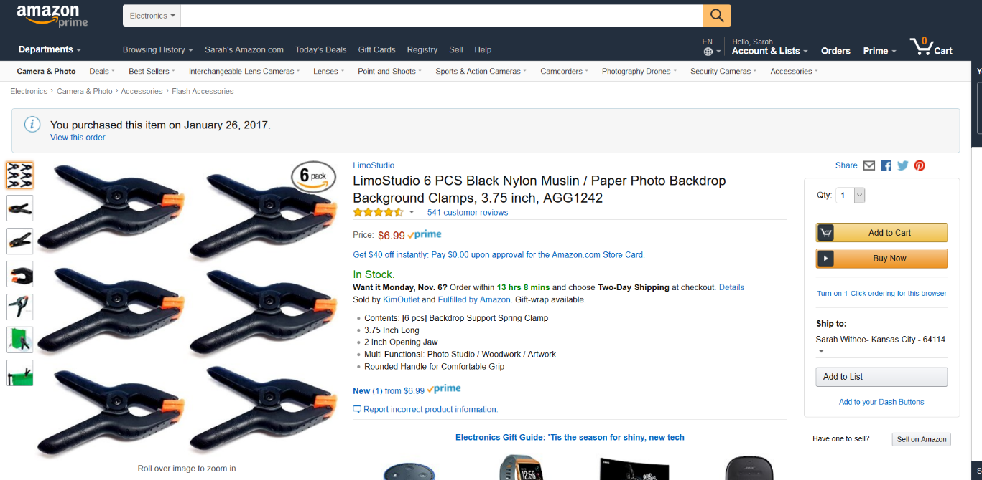
The “studio”
Notes:
… and some clips to hang it on… and for considerably under $100 I drastically improved the professional look of my show.

Slide 14
5.
Pursuing that Project when you have no energy to pursue it
… now what?
Notes:
I recorded that first episode in January, then the second in February, then a funk set in
Life really was dragging me down. Work was eating at me, life was more obnoxious, lost some friends in that time… just blah
Passion projects require a certain amount of energy, I just didn’t have that anymore.
What do you do?

Slide 15
When you have no more energy…
Write down EVERYTHING you were working on
Store things not where you expect to find now, but LATER
Give yourself permission to rest

Slide 16
6.
Going into production… again
Picking up where I left off
Notes:
When I had some more energy, I got back to editing
I put together an episode in its final form, and finally put it on the website with the domain I had owned for months and not used
Made a second one and released it
Put that twitter account to use
Slowly, people started to see it and started to respond to it

Slide 17
7.
Going into the future
Let’s start with the first set of slides
Notes:
a. Designed "Rest of Us in Tech" to be very open and versatile. I plan to expand
b. Phase 1: Podcast
c. Phase 2: Conference talks/webinars (because there's a lot of people with great things to say that don't get to have their stuff recorded)
d. There's phases 3 and 4, but reluctant to admit in case of failure

Slide 18
8.
Things I’ve learned
There were SO many…

Slide 19
Things I learned…
Side projects should be about passion, NOT “something I have to do”

Slide 20
Things I learned…
The worthwhile projects are a TON of work!
(Good support networks help you keep your momentum, though)

Slide 21
Things I learned…
“Failure” isn’t necessarily permanent
Notes:
"Failure" isn't necessarily permanent. I failed releasing my podcast on Jan 1, Jan 15, Feb 1, Feb 15, Mar, April... finally released it in June, 7 months after I started work on the first part of it

Slide 22
Things I learned…
What’s the end goal? Focus on THAT
Notes:
"Failure" isn't necessarily permanent. I failed releasing my podcast on Jan 1, Jan 15, Feb 1, Feb 15, Mar, April... finally released it in June, 7 months after I started work on the first part of it

Slide 23
9.
Conclusion
The end!
Notes:
a. sometimes silly little fractions of ideas can build together into something big. Don't lose those fractions of ideas
b. Doing something for the greater good will let you feel better, even if it's not a super popular idea
c. something something I want a third point here
d. and follow, subscribe, like, retweet. (just kidding)

Slide 24
Credits
Special thanks to…
Presentation template by SlidesCarnival
The wonderful beta testers and guests of my podcast
My wonderful support network

Slide 25
Like
Subscribe
Share
Us on Twitter!
To on iTunes, Google Play, YouTube
With all of your friends!
Notes:
… kidding!

Slide 26
Like
Subscribe
Share
Us on Twitter!
Just Kidding!
To on iTunes, Google Play, YouTube
With all of your friends!
Notes:
… kidding!

Slide 27
THANKS!
Any questions?
You can find me at @geekygirlsarah or hello@sarahwithee.com

